Slide 1




NEXT GEN EMPLOYABILITY PROGRAM
Creating a future-ready workforce
Team Members
College Name
Student Name : Asmitha. S
Student ID : au960221104035
Arunachala College of Engineering for Women

Slide 2

CAPSTONE PROJECT SHOWCASE
Project Title
Car Rentals Application with Django Framework
Abstract | Problem Statement | Project Overview | Proposed Solution | Technology Used | Modelling & Results | Conclusion

Slide 3
Abstract Car rental application is a project which aims in developing a computerized system to maintain all the daily work of car rental. This project has many features, like facility of customer login. There is no delay in the availability of any car information, whenever needed, car information can be captured very quickly and easily. The customer should create a new account before logging in and can log into the system with created account. Then can book the available cars and can book this car. The booking reservation system facilitates easy booking processes for customers, allowing them to select desired vehicles, specify rental dates. This project is developed using Django for backend; HTML, CSS, JavaScript for frontend; our application ensures scalability and reliability. Overall, this project of ours is designed to help anyone make it easier during the process of renting a car in the best possible way, as well as reducing human efforts and obtaining the best offers.
Source :

Slide 4
Problem Statement In the car rental industry, the absence of a unified and efficient management system often leads to operational inefficiencies and customer dissatisfaction. Existing platforms struggle with issues like limited inventory visibility, complex booking procedures, and inadequate security measures. Furthermore, the lack of a standardized solution hampers scalability and inhibits the ability to adapt to evolving market demands. To address these challenges, this project aims to develop a modern car rental application utilizing the Django framework. The application will focus on integrating features such as simplified booking processes, and scalable architecture. By doing so, the goal is to revolutionize the car rental experience, offering a seamless and secure platform for both customers while fostering adaptability and growth in a dynamic market landscape.
Source :

Slide 5
Project Overview The car rental application project seeks to develop a comprehensive platform using the Django framework to simplify the vehicle rental process for customers. Customers will benefit from a seamless experience, offering intuitive interfaces for browsing available vehicles, selecting rental options, making reservations. Prioritizing scalability, security, and responsiveness across different devices, the project aims to deliver a high-quality and efficient car rental application that caters to the needs of customers, setting a new standard for excellence in the industry.
Source :

Slide 6
Proposed Solution Our solution involves building a comprehensive car rental platform using Django, encompassing user management, vehicle inventory control, advanced search and filtering capabilities, and an efficient booking process. Users will be able to register securely, browse available vehicles based on their preferences. With a responsive design and performance optimization, the application will ensure a smooth user experience across devices while prioritizing data security measures to protect user information. Additionally, scalability and flexibility will be emphasized, allowing for future enhancements and business growth.
Source :

Slide 7
User Authentication and Authorization
Implement a robust user authentication system to allow users to create accounts, sign in securely, and manage their profiles. Ensure appropriate authorization levels for different user roles, such as customers and administrators.
Vehicle Inventory Management
Develop a module for administrators to manage the inventory of available vehicles. This includes functionalities such as adding new vehicles, updating vehicle details (e.g., model, year, mileage), and removing vehicles from the inventory when they are rented out or unavailable.
Search and Filtering
Implement a powerful search and filtering system that allows users to easily find vehicles based on criteria such as location, date range, vehicle type, and features. Provide options for sorting search results to enhance user experience.
Booking and Reservation
Create a seamless booking and reservation process that enables users to select their desired vehicle, choose rental dates and times, and make reservations securely. Include features for managing multiple bookings, modifying reservations, and canceling bookings if necessary.
Source :

Slide 8
Responsive Design and Performance Optimization
Ensure the application is designed with a responsive layout that works seamlessly across different devices. Implement performance optimization techniques to enhance speed and responsiveness.
Data Security Measures
Implement robust security measures to protect user data and prevent unauthorized access. This includes encryption of sensitive information, input validation, and protection against common web vulnerabilities.
Scalability and Flexibility
Design the application with scalability in mind to accommodate growth and changing business needs. Utilize Django's flexibility to easily extend functionality and add new features in the future.
Models
Define Django models to represent entities such as users, cars, rental bookings, payments, etc. Ensure proper relationships between these models (e.g., a user can have multiple rental bookings, a car can have multiple bookings, etc.).
UI/UX Design
Design a user-friendly interface for both customers and administrators. Use Django templates along with HTML, CSS, and JavaScript for server-side rendering. Alternatively, consider using frontend frameworks like React or Vue.js for building a dynamic, single-page application (SPA) with a Django backend.
Source :

Slide 9


Technology Used
Front-end
Back-end
Source :

Slide 10
Modelling & Results In designing a car rental application with Django framework, optimal modeling involves defining key models such as User, Car, Booking, Payment, and optionally Review. These models encapsulate essential entities and relationships, facilitating user authentication, car listing, booking management, payment handling, and feedback collection. The results of such a system manifest in a seamless user experience, where users can easily browse available cars, book rentals, manage bookings via a user dashboard, and receive notifications on booking status and payment updates. Additionally, administrators can efficiently oversee car listings, bookings, payments, and user accounts through a dedicated admin panel, ensuring smooth operations. Integration with a secure payment gateway enables seamless online transactions, while analytics and reporting functionalities provide valuable insights for business optimization. By prioritizing these modeling considerations and delivering these results effectively, a comprehensive and user-centric car rental application can be realized with Django framework, poised for scalability and user satisfaction.
Source :

Slide 11
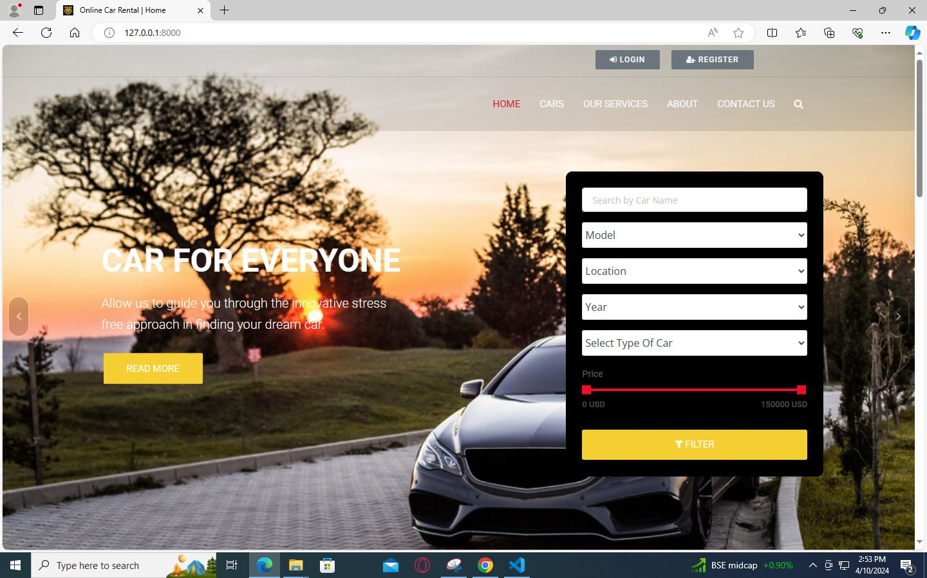
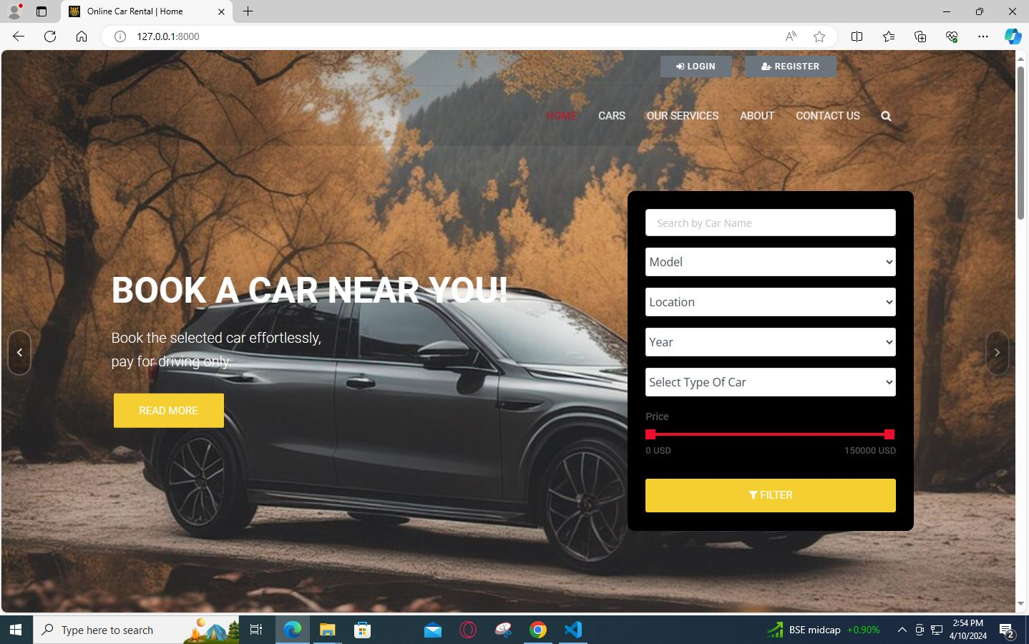
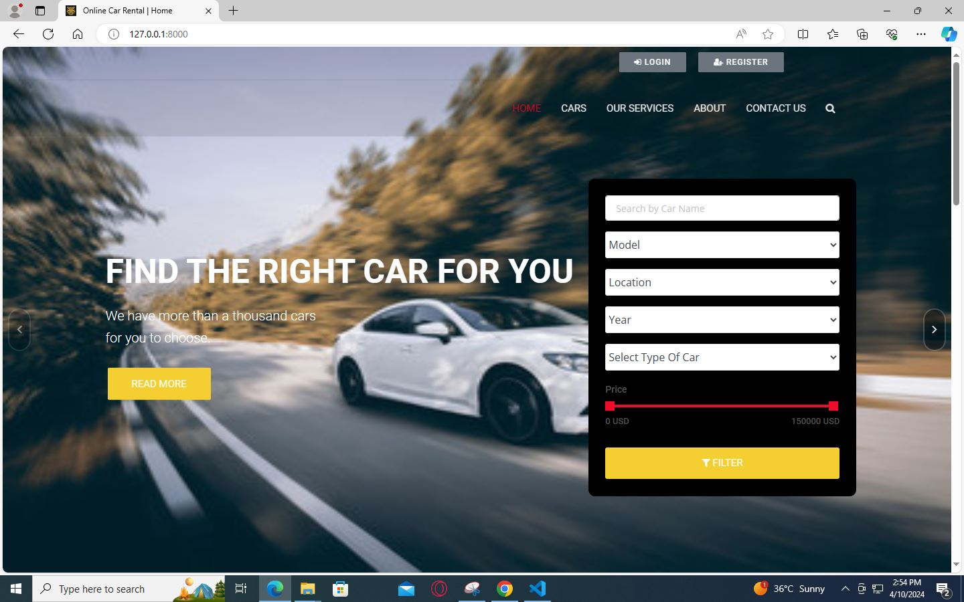
Homepage

Slide 12
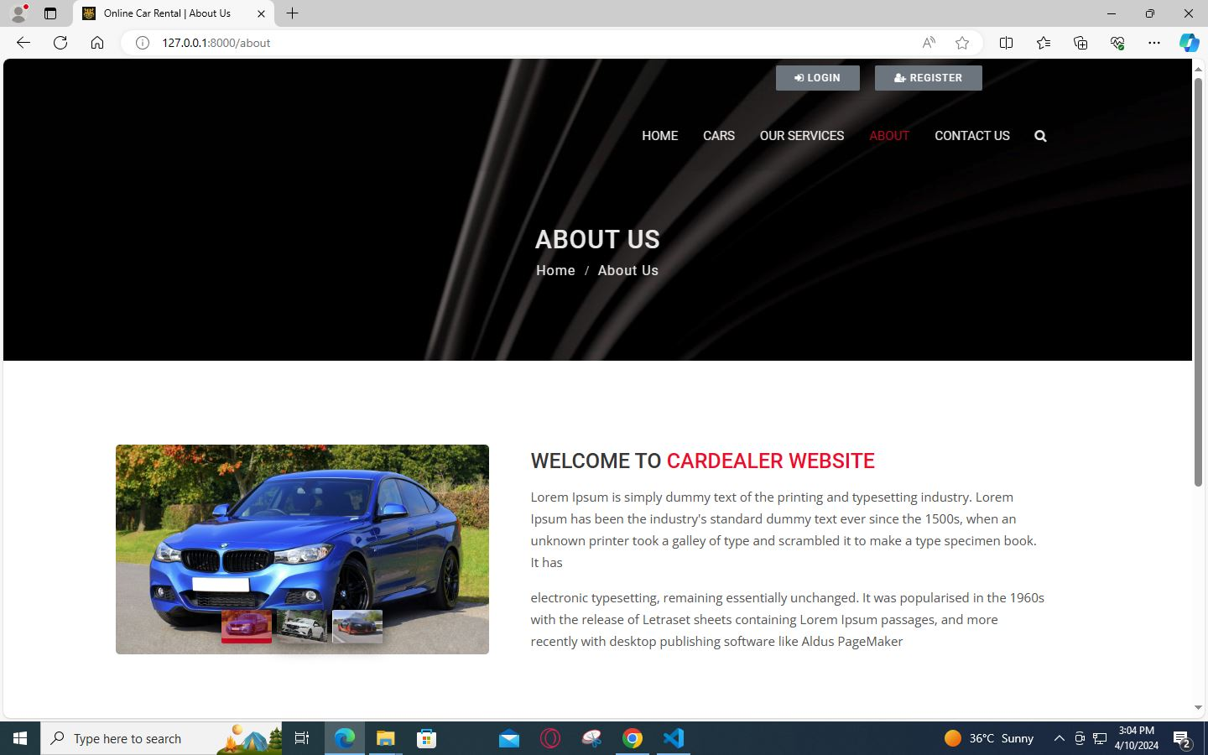
About-Us-Page

Slide 13
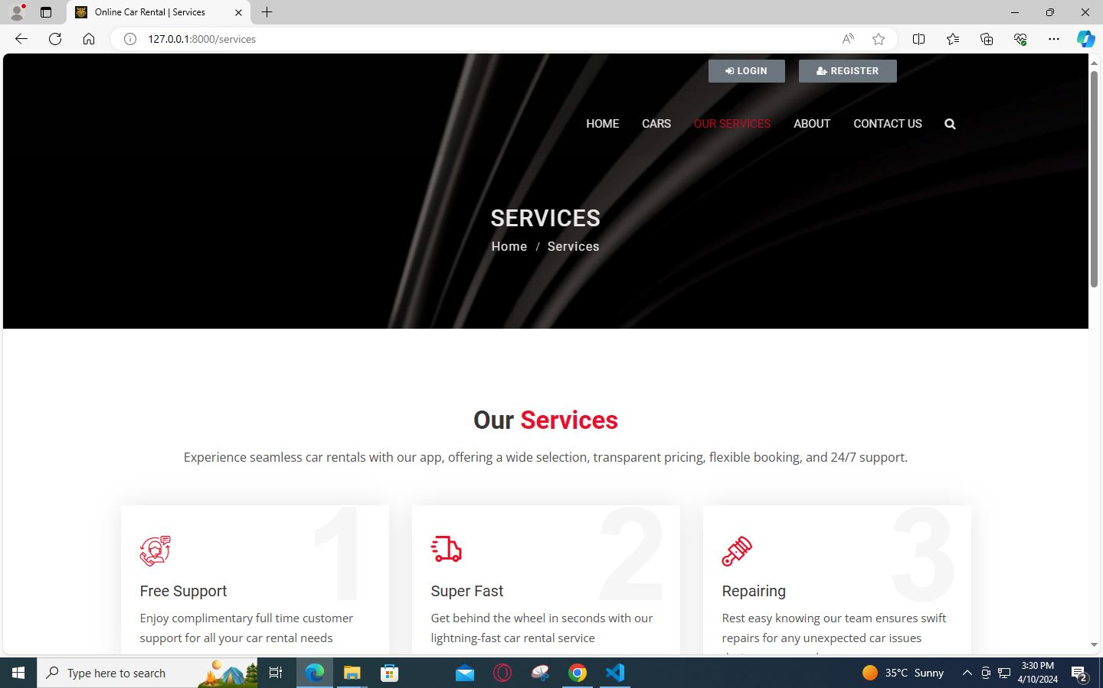
Service-Page

Slide 14
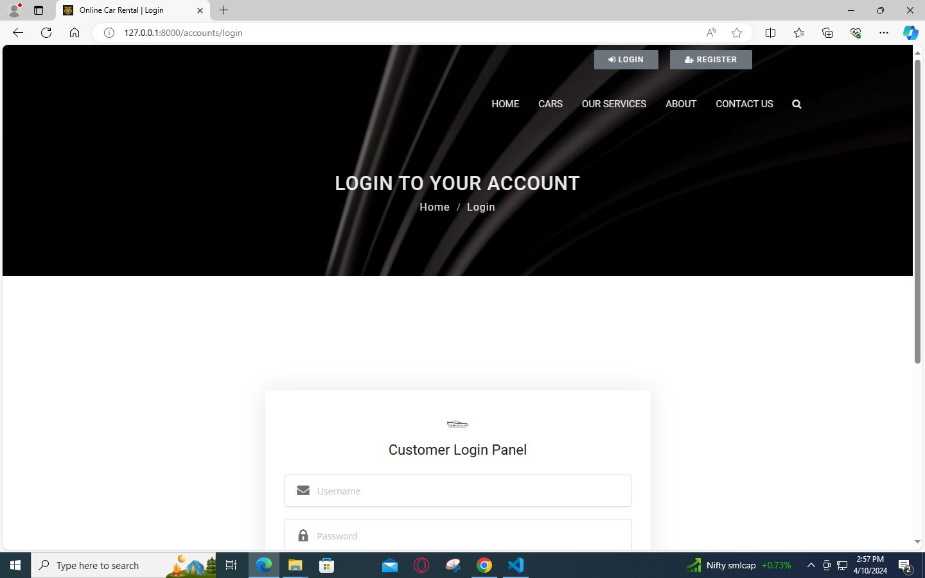
Login-Page

Slide 15
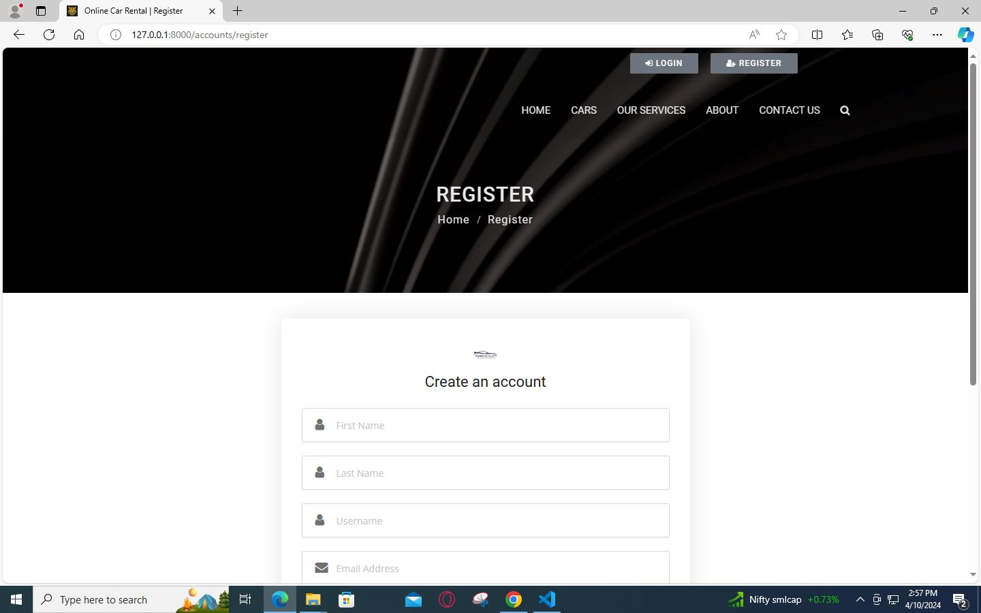
Register-Page

Slide 16
Future Enhancements
Dynamic Pricing
Implement dynamic pricing algorithms that adjust rental rates based on factors such as demand, seasonality, availability, and vehicle popularity. This can optimize revenue generation and encourage bookings during off-peak periods.
Vehicle Tracking
Integrate GPS tracking systems to monitor the real-time location and status of rental vehicles. This feature enhances fleet management, enables better scheduling of vehicle maintenance, and provides added security for both renters and the rental company.
Mobile App Development
Develop dedicated mobile applications for iOS and Android platforms to offer a more convenient and intuitive rental experience for users on the go. Mobile apps can provide features such as quick booking, push notifications, digital key access, and seamless payment integration.
Online Payment Integration
Add a secure online payment option to the car rental app, allowing users to easily pay for bookings with credit/debit cards or digital wallets. This simplifies the booking process, improves convenience, and boosts customer satisfaction.

Slide 17
Conclusion Building a car rental app with Django framework provides a solid base for making a user-friendly, safe, and adaptable platform. By using Django's tools and integrating features like payment systems and mobile access, developers can create a smooth experience for both renters and managers. From listing cars to booking and beyond, Django allows for a range of features that improve the rental process and help the business grow. With ongoing improvements and attention to detail, a Django car rental app can succeed in its market, providing value to users while running efficiently and securely.
Source :

Slide 18
Thank You!
Notes:
Thank You !!

